Slide 1
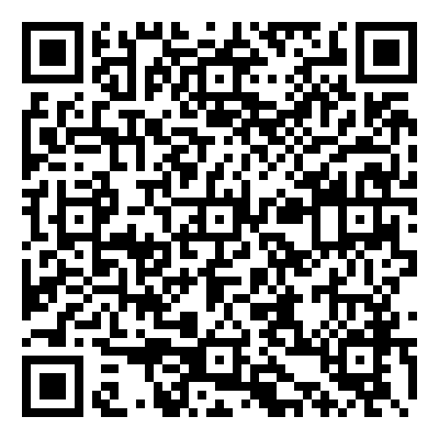
Cusack’s Quizizz Presentation QR code
https://www.cusack2.com/KCHS23_24/202406Jun/14_Train/Assets/Quizizz_Presentation.pdf
https://quizizz.com/admin

Slide 2
Welcome
Welcome to my presentation on Quizizz! I'm excited to introduce you to this powerful learning platform that offers multiple tools to make your classroom run smoothly and engagingly. Quizizz offers many Artificial Intelligence features.
Notice that I have two video links YouTube or my web site. Reason: The Klein ISD YouTube filter may block you on one of them.
I included short videos at the bottom to review each slide covered in this presentation.
Video on Overview, Account signin URL (www.cusack2.com)
Video (YouTube Version)

Slide 3
Goals:
Gain a practical understanding of how Quizizz works by exploring its various features.
Learn how using Quizizz can enhance your effectiveness as a teacher.
Understand why Quizizz stands out as the most effective AI tool for education compared to other current educational products.

Slide 4
Overview
Quizizz is designed to enhance classroom interaction and engagement. Today, we’ll focus on its features and benefits without requiring you to sign in due to our limited training period of less than an hour. I have found this to be one of best product for increase productivity. (note: I an NOT be being paid by the company who owns Quizizz)

Slide 5
Account Setup
After this session, I recommend setting up an account at the start of the school year. Quizizz offers all its features free for the first 30 days. After that, you get a more restrictive version.
You can request Klein ISD to buy a school license or pay for your own subscription.
I paid for my own copy with all the features, and it has significantly increased my efficiency in daily class preparation.

Slide 6
Quizizz URL Link to signon
You can access Quizizz at https://quizizz.com/ Since I already have an account, I’m signed in and can show you the main Quizizz page.

Slide 7
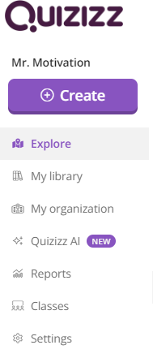
Layout of Quizizz
Let’s review the layout of Quizizz, which includes the following sections:
- Explorer
- My Library
- Reports
- Classes
Video on Layout – Click here (www.cusack2.com)
Video (YouTube Version)

Slide 8

Demo a Quizizz
Here’s a demo Java Inheritance Quiz for you to explore:
- Java Inheritance Quiz sample quiz
- You can assign it as homework or in real-time.
- Quizizz also supports accommodations with Google Classroom and Schoology.
Video to Demo a Quizizz (www.cusack2.com).
Video (YouTube Version)

Slide 9
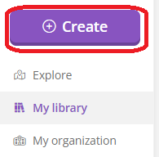
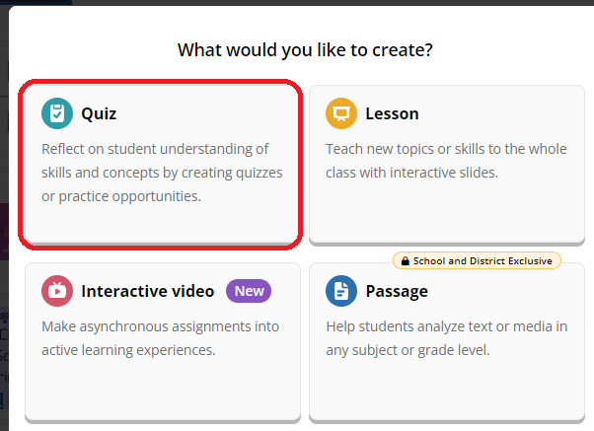
Create by importing a PDF
- Click on the 'Create' icon.
- Click on the “Assessment” in the upper left corner.
- Import questions from a PDF:
- Document to use - '1.2.16 - Key - Cryptographic Attacks.pdf’ – Click here.
Video to import a PDF (www.cusack2.com).
Video (YouTube Version)

Slide 10
Create using a text file
- Click on the 'Create' icon.
- Click on the “Assessment” in the upper left corner.
- copy from the text file below:
- Data is on the next line:
-- ‘PasteText.txt’ – Click here.
Video to create using a text file. (www.cusack2.com).
Video (YouTube Version)

Slide 11
Create with an excel spreadsheet
- Click on the 'Create' icon.
- Click on the “Assessment” in the upper left corner.
--Spread sheet is on the next line:
'349QuestionsUploadCyberDigitalForensics.xlsx'
Video to import an excel sheet (www.cusack2.com).
Video (YouTube Version)

Slide 12
Create from a web URL
- Click on the 'Create' icon.
- Click on the “Assessment” in the upper left corner.
Generate from Web url:
(Java Glossary and the Core Concepts in the Java Language)
https://stackify.com/java-glossary/
Video Web Url’s (www.cusack2.com).
Video (YouTube Version)

Slide 13
Create from a YouTube
Click on the 'Create' icon.
Click on the “Assessment” in the upper left corner.
Generate from YouTube: Introduction to Generative Fill | Adobe Photoshop https://www.youtube.com/watch?v=Sp6K3qpVFO0
Video using YouTube as input (www.cusack2.com).
Video (YouTube Version)

Slide 14
Creating using search
Click on the 'Create' icon.
Click on the “Assessment” in the upper left corner.
- Search: Cyber
- Enter Manual Questions: Examples
Video using search of other Quizizz. (www.cusack2.com).
Video (YouTube Version)

Slide 15
See Images in a Quizizz
You can enhance your quizzes by adding images. Click on this link to see an example: Quizizz with Images:
Cessna 172 Six Pack image https://quizizz.com/admin/quiz/6645521cf961d836b399c256?source=quiz_share
Video using images in questions. (www.cusack2.com).
Video (YouTube Version)

Slide 16
Reports
Quizizz provides detailed reports to review student performance. Here’s an example report on Java Hash Maps:
Report: Sample on the next line.
When you try the link, it will not work. https://quizizz.com/admin/reports/6642b7f1cc6f8a26937f5c8c?source=report
Video about quizizz reports. (www.cusack2.com).
Video (YouTube Version)

Slide 17
Collections
Organize your quizzes by subject matter using Collections.
Win $25 gift card
Conclusion
Getting Credit with a QR code
Video about Collections (www.cusack2.com).
Video (YouTube Version)

Slide 18
Win a $25 gift card
Win a $25 Amazon gift card
Follow the direction below. ONLY one card will be given to the first person who meets the requirements.
(click here for the data file to recreate the quizizz below if you want.)
Try the quizizz below. Click on the link below:
If you are the first one to get a 100, I will give you a $25 gift card.
I included the answer for each question in the 5th option.
Try it as many times as you want. Do not forget your full name.
Once you have your 100, screen print it and save it to a file.
attached it to an email it to jcusack1@kleinisd.net
You have until next Friday June 14, 2024.
Click here or copy and paste the link below into your URL.
https://quizizz.com/join?gc=67935196

Slide 19
Conclusion
Thank you for your time. I hope you find Quizizz as beneficial for your teaching as I have. Feel free to reach out to me if you have any questions.

Slide 20
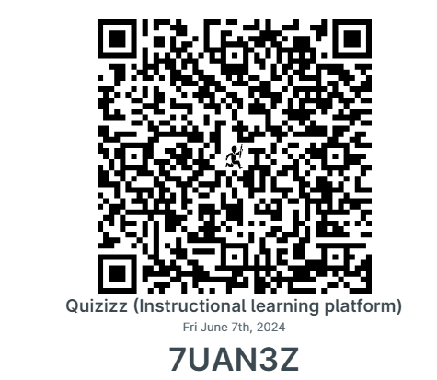
To confirm your attendance, log into KickUp through the Klein ISD Dashboard & enter the code below OR scan the QR code to the right. →
Paste QR Code Image Here
(On top of this box.)
KickUp Attendance Code: 7UAN3Z
Notes:
Miriam 1

Slide 21

For PNP attendees, to confirm your attendance, please click on the link below or scan the QR code →
Paste QR Code Image Here
(On top of this box.)
Private Non-Profit Attendance Link: bit.ly/Sum24PNP
Notes:
Miriam 1

Slide 22
Contact Information
Joe Cusack
Klein Collins High School
Computer Science Instructor
Technology Applications Instructor
Cyber Security Instructor
jcusack1@kleinisd.net
713.569.5240

Slide 23
Joe Cusack’s short Bio:
Worked in the Computer Science industry for 10 plus years.
I have taught Computer Science for 8 years at Klein Collins high school.
I will be teaching 11 courses for the 2024-2025 school year.
(7 periods with up to 4 co-seated courses per period)
AP Computer Science A (Java)
AP Computer Science Principles
Klein Prep-Computer Science (Java)
Computer Science II (Python)
Computer Science III
Computer Science Independent Study I
Computer Science Independent Study II
Principles of Cybersecurity
Digital Forensic
Cyber Capstone
Video Game Programming Advanced (Unity)
I am the sponsor for the Computer Science UIL team, Girls who code, and the Aerospace/Aviation Club.

